Slide 1
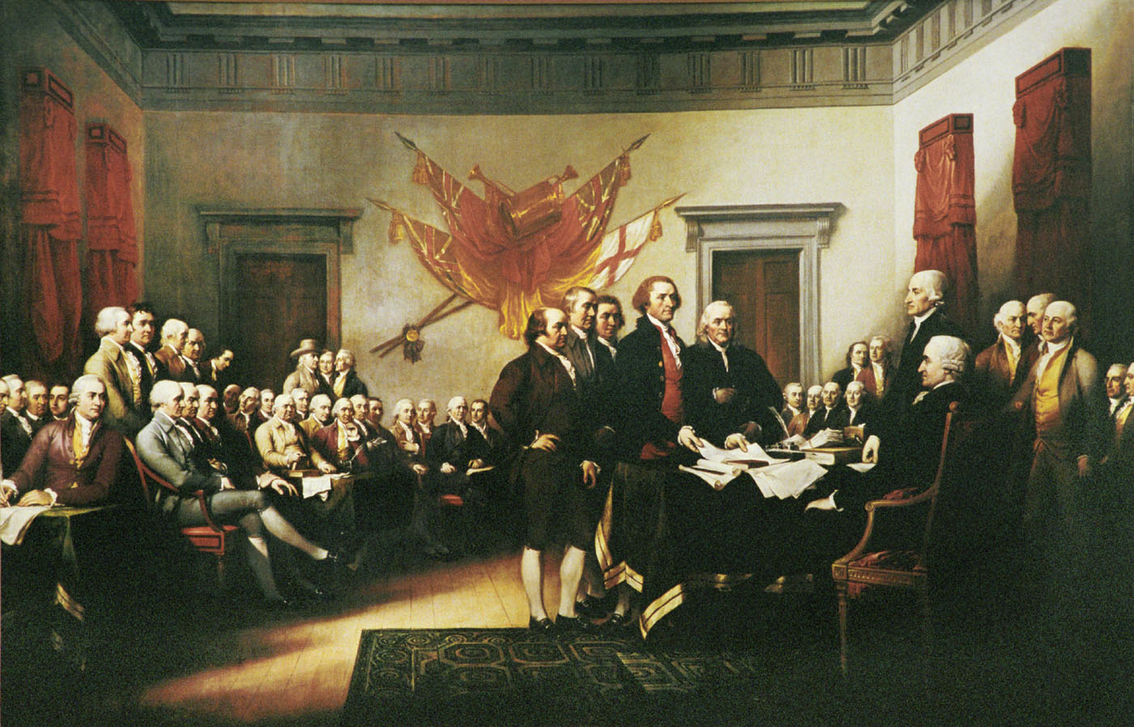
Unit 3 A NEW NATION

Slide 2
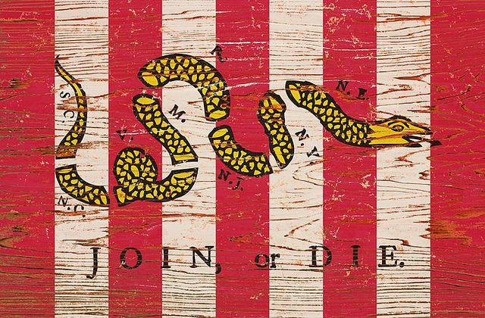
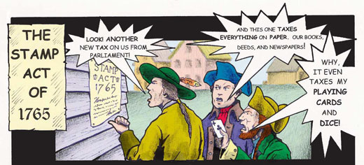
I. The Road to Revolution
The Acts
The Stamp Act
Sam Adams
Sons of Liberty

Slide 3
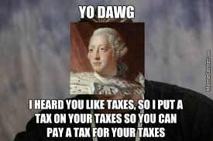
Declaratory Act
Colonists outraged
No taxation without Representation
Boycott of English products

Slide 4
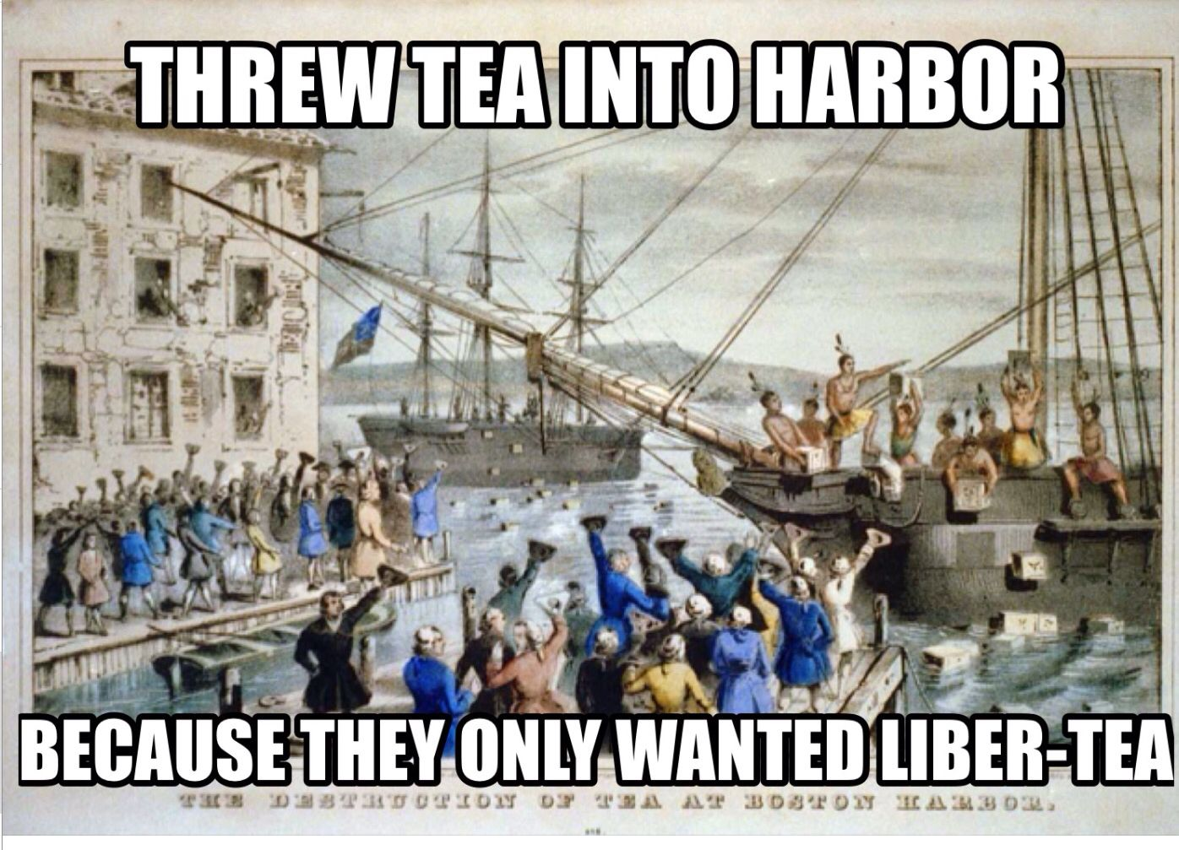
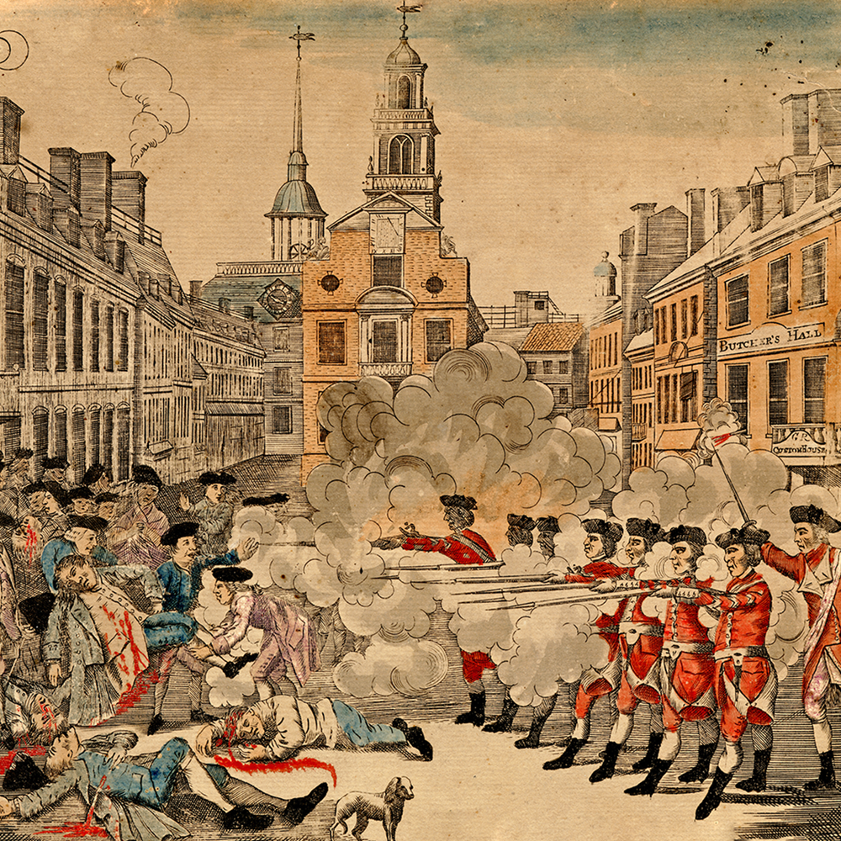
Townshend Acts
Boston Massacre- 1770
Boston Tea Party- 1773

Slide 5
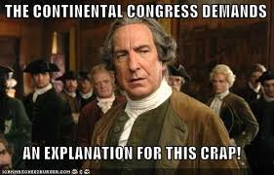
Intolerable Acts- 1774
Martial Law
Boston Harbor Shut Down
Quartering Act created
First Continental Congress
Declare colonies may run themselves
Support protestors
Right to defend themselves
They shall meet again

Slide 6
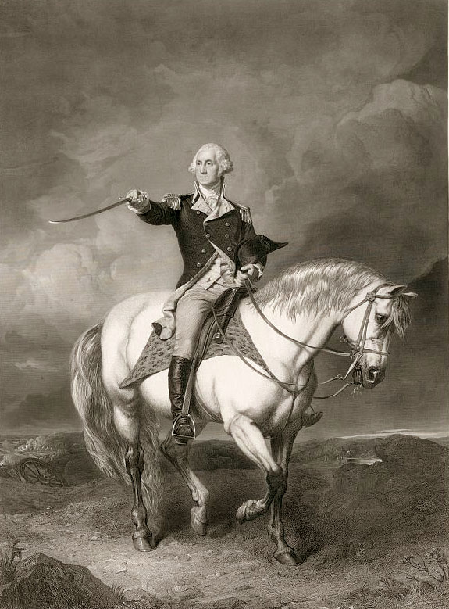
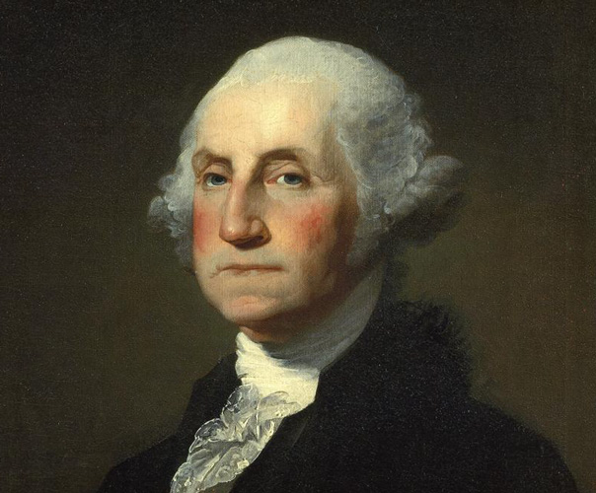
II. The American Revolution
Declaring Independence
Attempts at reconciliation
Olive Branch Petition
King George refuses
Preparations for war
George Washington put in charge of the Continental Army
England hires Hessians (mercenaries)

Slide 7
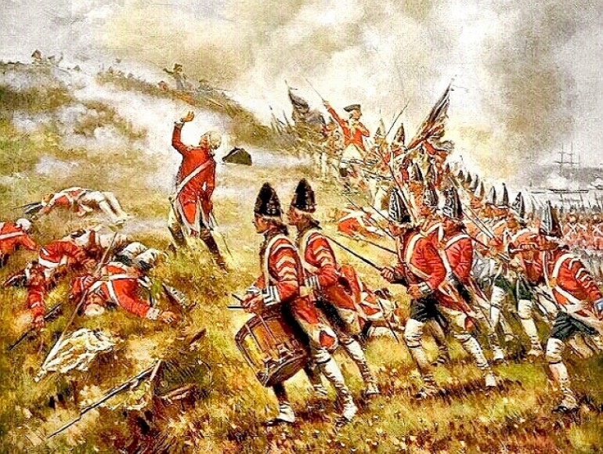
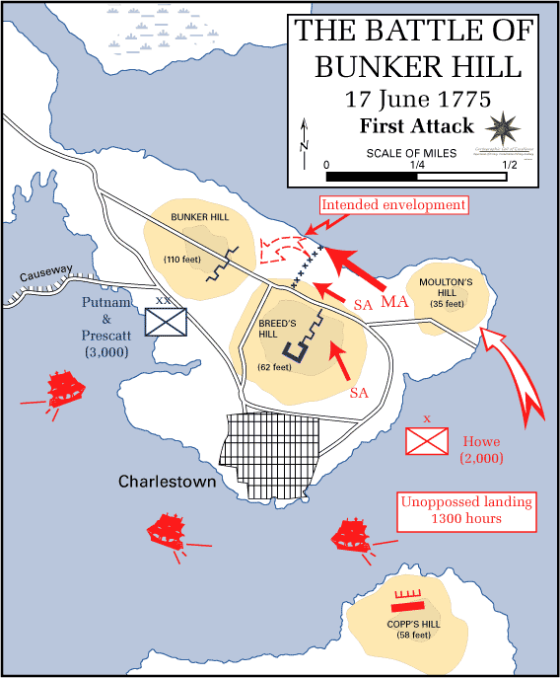
3. Battles begin (1775)
a. Bunker Hill (W/L?)
b. Redcoats leave Boston (1776)

Slide 8
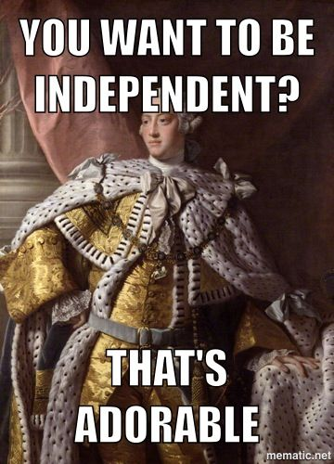
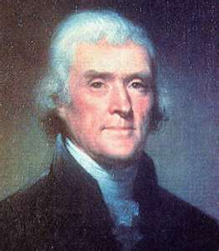
4. July 4th, 1776 (The Historic Day)
a. Thomas Paine/Common Sense
1. Colonies received no benefits
2. They were being exploited
b. Declaration of Independence (Thomas Jefferson)
1. Treasonable offense
2. Declaration
a. Why we are doing this
b. Our rights
c. Our complaints
d. Declares our independence

Slide 9
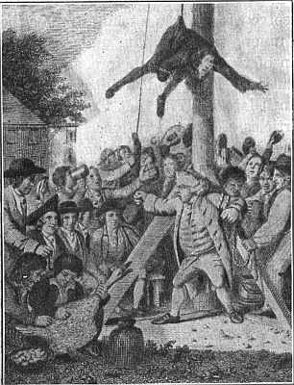
5. Colonists choose sides
a. Patriots
b. Loyalists/Tories

Slide 10
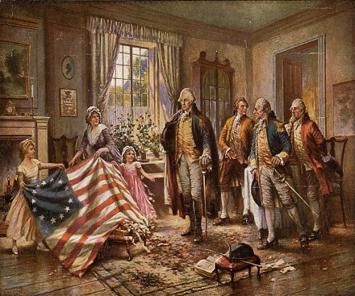
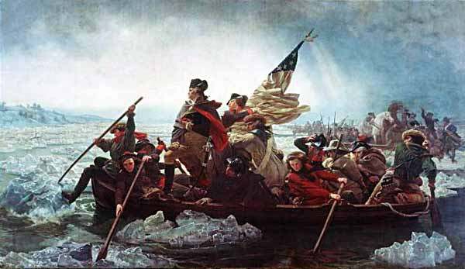
B. Revolutionary War
1. War in the North
a. Washington loses NY
b. Continental Army on the verge of collapse
c. Success in New Jersey
1. Trenton
2. Princeton
d. King is furious

Slide 11
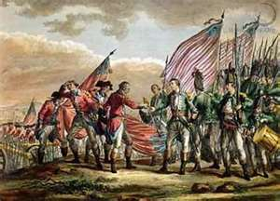
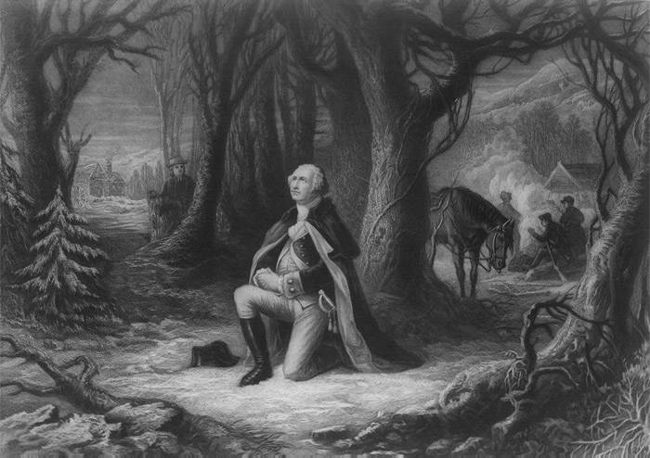
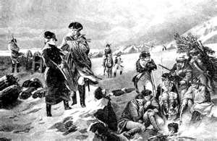
e. Battle of Saratoga
1. Major British army defeated
2. Treaty of Alliance with France
3. European countries offer America aid
f. Terrible winter at Valley Forge
g. Benedict Arnold commits treason

Slide 12
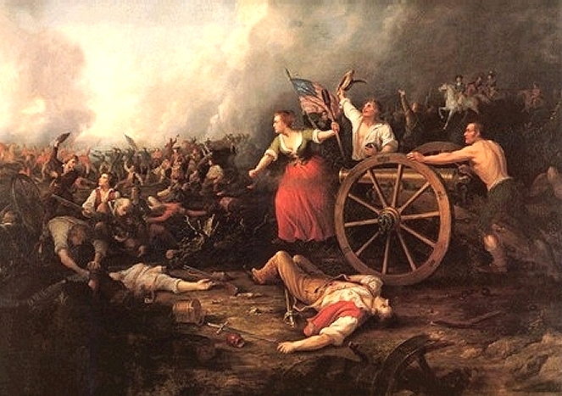
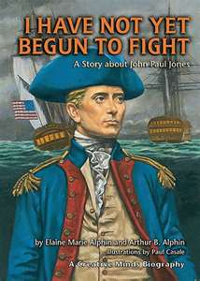
2. Other areas of War
a. England more encouraged in the South
b. England dominates the Sea (U.S. small victories- John Paul Jones)
c. African-Americans join the fight (both British/American)
d. Women support the fight
1. Non-combat roles
2. Combat roles (disguised themselves)

Slide 13
How to pay for the war?
Loans
Ignore bills
Inflation
Profiteering

Slide 14
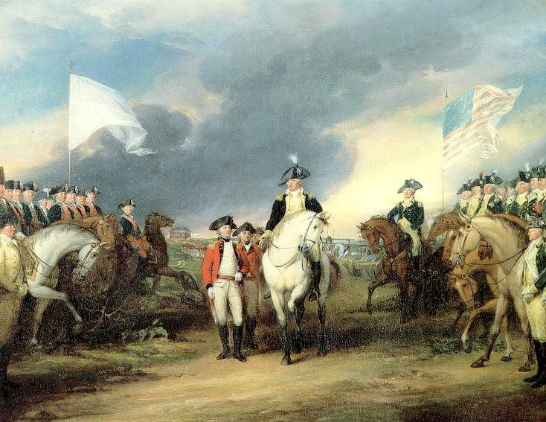
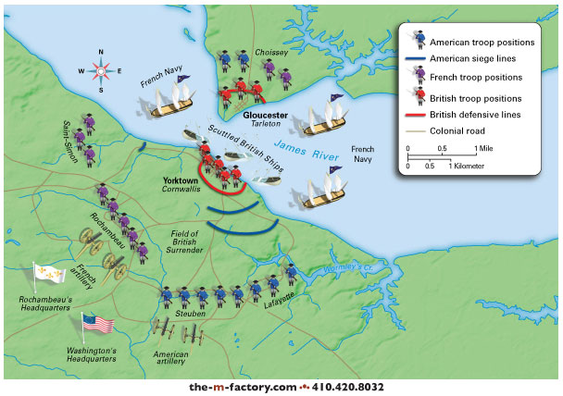
U.S.A.! U.S.A.! U.S.A.!
4. Colonies are victorious
a. American/French forces force Gen. Cornwallis to surrender after the Battle of Yorktown (1781)
b. Treaty of Paris- ends the war (1783)
c. Washington retires and worries

